Slide 1
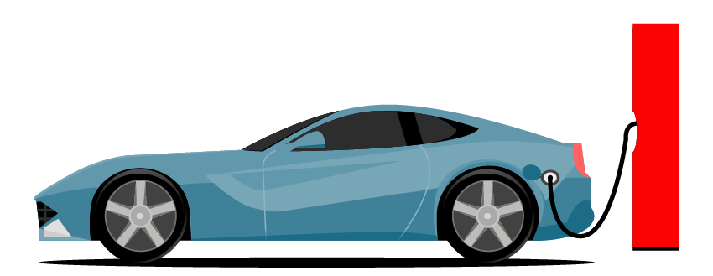
Basic Details of the Team and Problem Statement
TEAM NAME: TECH_BOSS
IDEA TITLE: ELECTRIC VECHICLE CHARGING SYSTEM
TEAM LEADER NAME: DEVADHARSHINI U
DOMAIN NAME: SMART CITY
PROBLEM STATEMENT: LACK OF ADEQUATE CHARGING STATIONS AND NO MEANS OF COMMUNICATION WITH VEHICLE DRIVERS , ABOUT THE CURRENT CAPACITY OF CHARGING STATIONS.

Slide 2
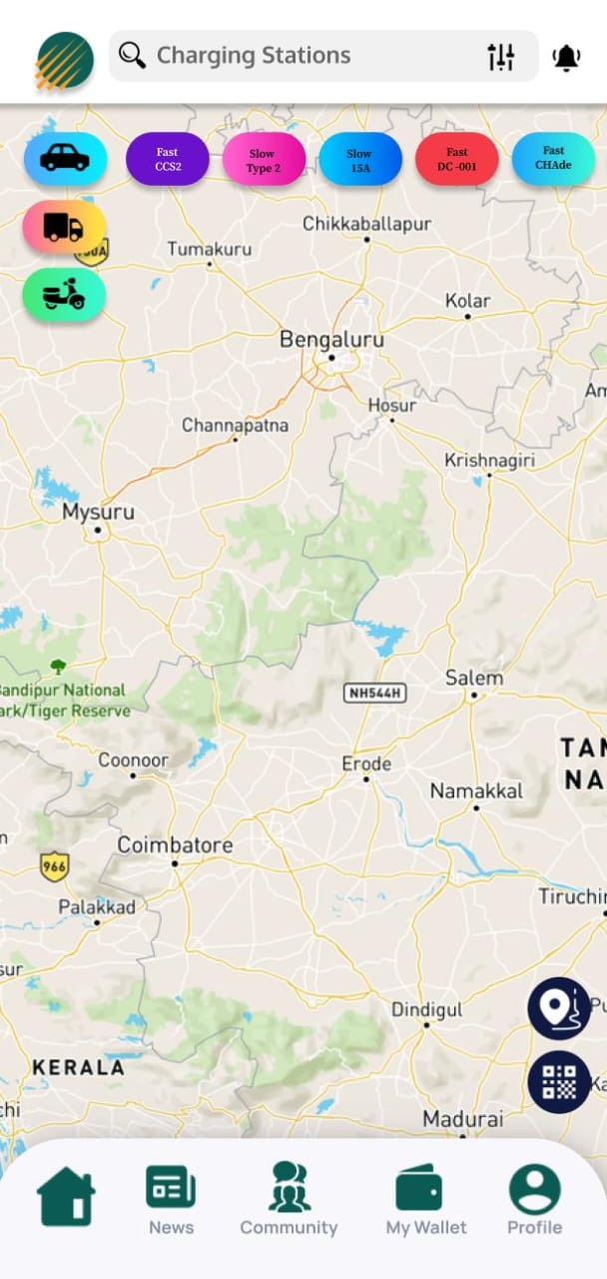
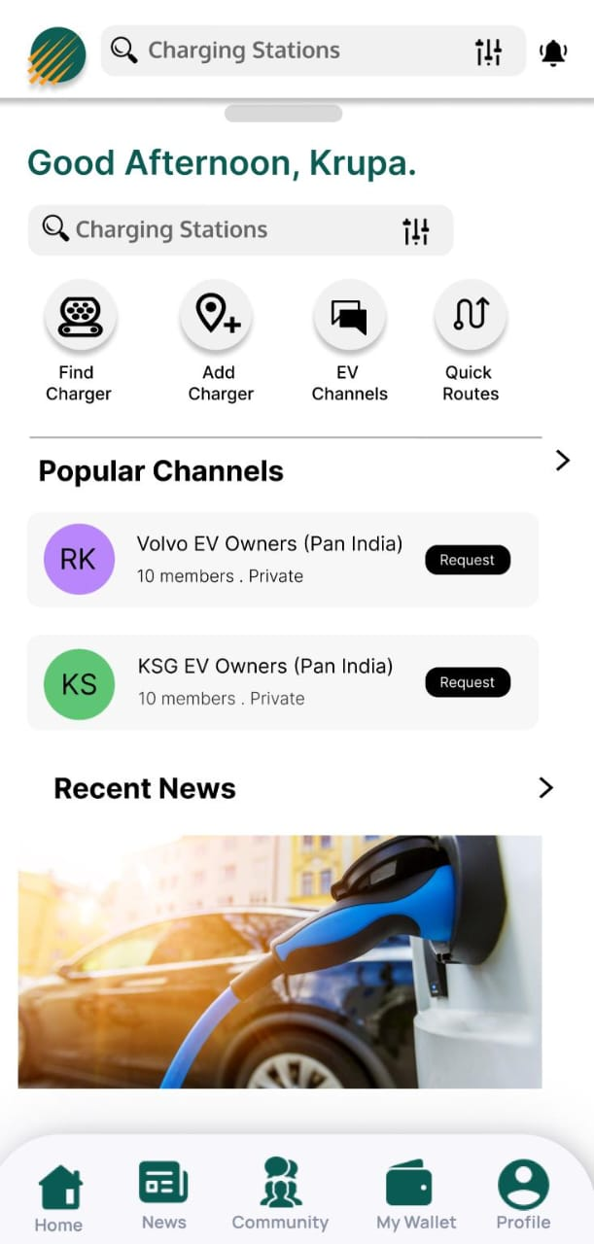
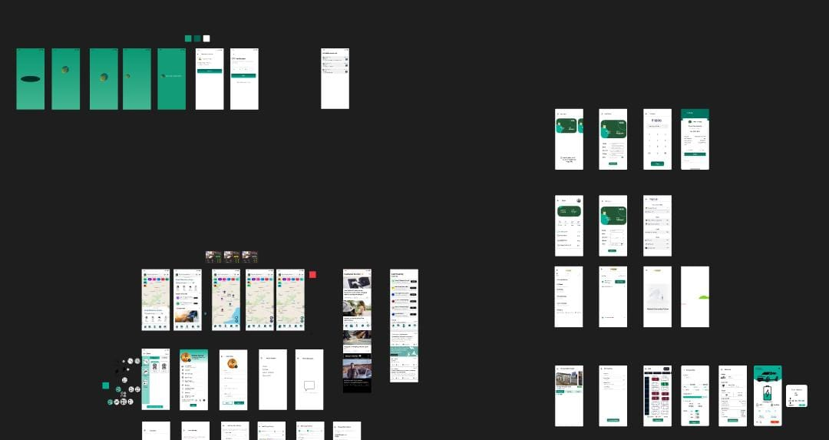
Idea/Approach Details
In recent years, urban areas have faced increasing challenges related to traffic congestion, air pollution, and carbon emissions.
Electric vehicles (EVs) present a promising solution to address these issues while promoting sustainable transportation.
Creating an user-friendly EV charging network booths that maximizes the renewable energy consumption in road transportation which in turn helps to achieve net zero.
Robust charging infrastructure for EV cars, buses, 2-wheelers & 3-wheelers.
These stations are certainly the future. Real time availability of charging stations & capacity open source.
Slot booking & waiting options available at inbuilt lounges. AI integrated location & capacity tracker Integration of alternatives like solar panels during uncertainty.
Describe your Technology stack here:
FRONT END : FLUTTER AND DART
BACK END : GCP
WEB SOCKET CREATION IN API CALL(OCPP)
EV MANAGEMENT

Slide 3
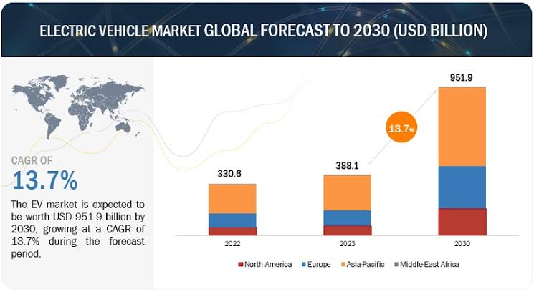
Idea/Approach Details
Describe your Use Cases here
Describe your Dependencies / Show stopper here
Environmental Impact: EVs produce zero tailpipe emissions, reducing air pollution and mitigating climate change.
Cost Savings: Lower operating costs due to reduced fuel and maintenance expenses compared to traditional vehicles.
Energy Efficiency: EVs are more efficient in converting energy from the grid to power the vehicle compared to internal combustion engine vehicles.
Improved Public Health: Reduced emissions lead to cleaner air, resulting in fewer respiratory illnesses and improved public health.
Noise Reduction: Electric motors operate quietly, contributing to quieter and more peaceful urban environments.
The successful adoption and implementation of electric vehicles (EVs) depend on several key factors and dependencies:
Charging Infrastructure
Battery Technology
Government Policies and Incentives
Consumer Awareness and Education
Vehicle Affordability and Availability
Range and Charging Speeds Collaboration among stakeholders, including automakers, Environmental and Energy Policies

Slide 4
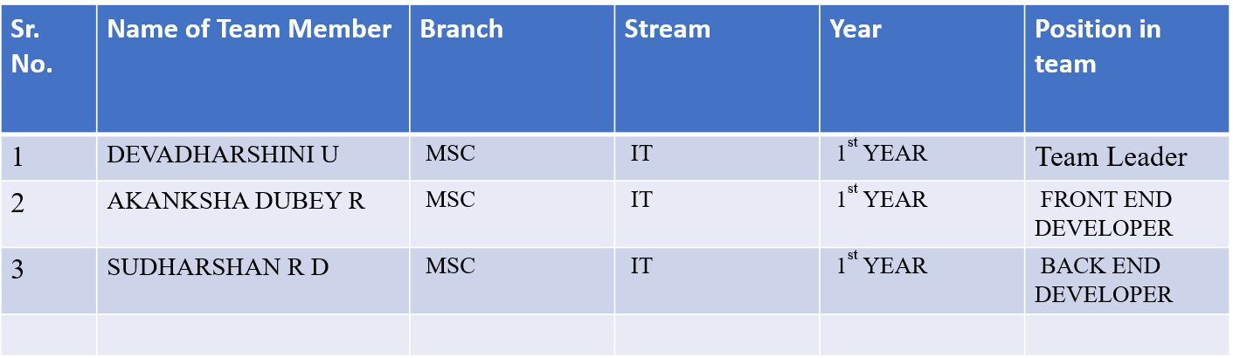
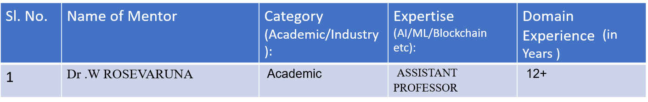
Team Member Details
Team Mentor/s Details

